Slide 1
Performance Testing Project
By: Ahmed Osama

Slide 2
What Is Performance Testing?
Performance Testing is a type of software testing that ensures the software applications perform well under their expected workload. It helps identify bottlenecks and provides insights on speed, scalability, and stability.

Slide 3
Purpose Of Performance Testing
The goal is to verify that the system can meet performance requirements such as throughput, response time, and user load.

Slide 4
Factors Governing Performance Testing:
Throughput
Response Time
Tuning
Benchmarking

Slide 5
Key Types of Performance Testing
1. Load Testing: Determines system behavior under expected load.
2. Stress Testing: Tests system behavior under extreme conditions.
3. Endurance Testing: Verifies system stability over time.
4. Spike Testing: Tests performance with sudden load spikes.
5. Scalability Testing: Checks system’s ability to scale up or down.
6.Volume Testing: Testing large data volumes to check for memory leaks and server capacity.

Slide 6
Performance Testing Tools
Popular performance testing tools include:
1. Apache JMeter
2. LoadRunner
3. Gatling
4. BlazeMeter
5. NeoLoad

Slide 7
Performance Testing Process:
Identify test environment: Determine the hardware, software, and network conditions under which the performance tests will be conducted.
Determine performance criteria: Define the specific performance metrics that will be measured, such as response time, throughput, and resource utilization.
Plan and design: Develop a detailed test plan, including test cases, data sets, and test scripts.
Configure test environment: Set up the test environment to match the production environment as closely as possible.
Run tests: Execute the performance tests according to the test plan.
Analyze and retest: Analyze the test results to identify performance bottlenecks and areas for improvement. If necessary, make changes and run the tests again.
Implement test design: Incorporate the findings from the performance testing into the system design or implementation to optimize performance.

Slide 8
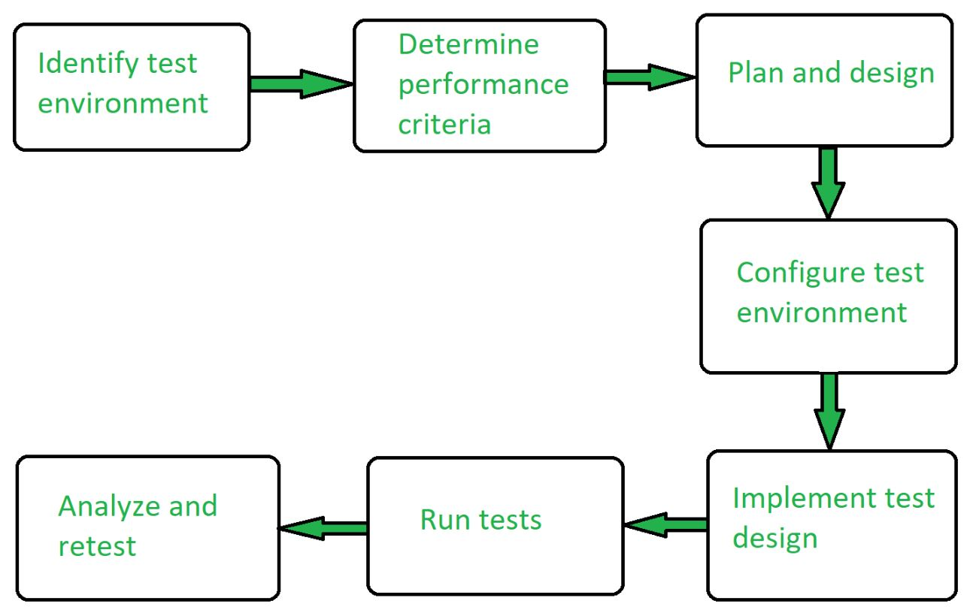
Performance Testing Process cont.:

Slide 9
Tools Used:
Blaze-Meter Recorder chrome plugin
Apache JMeter

Slide 10
Teste Done:
Opening Jumia.com
Searching for different products using data from CSV file
Load Testing by testing 50 user for 5 loops over 5 seconds
Stress test by testing 100 users 4 loops over 5seconds

Slide 11
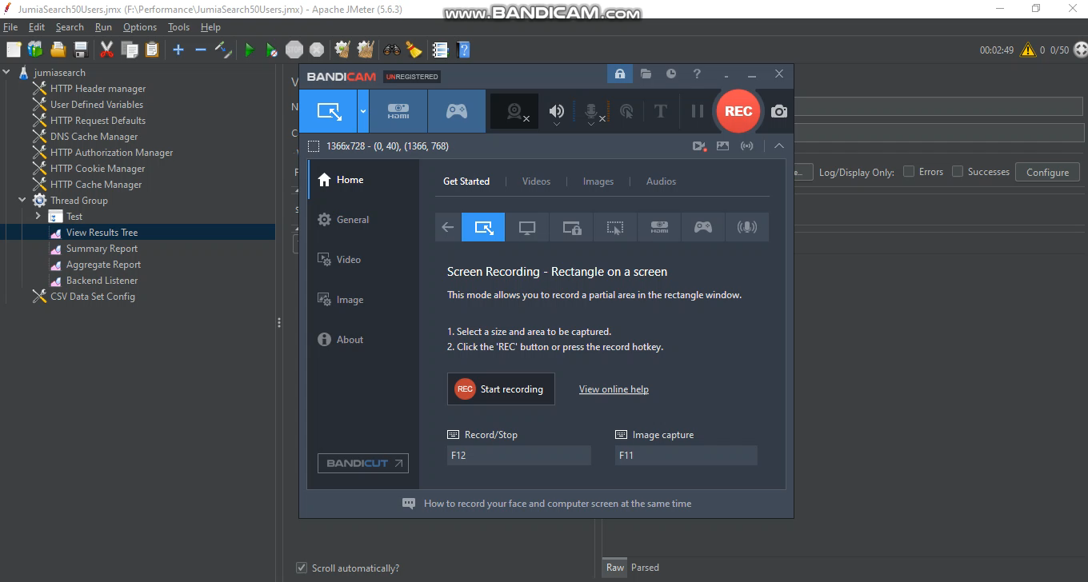
Video:

Slide 12

Thank You

